Slide 1
SENTIMENT ANALYSIS
CAPSTONE PROJECT
Presented By:
Jonnada Gangadhara Mani Nagendra
Bonam Venkata Chalamaiah Engineering College
Computer Science and Engineering

Slide 2
OUTLINE
Problem Statement
Proposed System/Solution
System Development Approach
Algorithm & Deployment
Result
Conclusion
Future Scope
References

Slide 3
PROBLEM STATEMENT
The objective of this project is to analyze customer reviews and feedback on restaurant services, including food quality, service, ambiance, and pricing, to gauge customer sentiment, understand satisfaction levels, and identify areas for improvement. Customer reviews are a rich source of information that can reveal both the strengths and weaknesses of restaurant services. By systematically analyzing this feedback, we aim to provide actionable insights that can help restaurant owners and managers enhance the quality of their services, improve customer satisfaction, and increase overall business performance..

Slide 4
PROPOSED SOLUTION
The system addresses the challenge of sentiment analysis in the restaurant industry through a robust approach combining natural language processing (NLP) techniques and machine learning models.
Data Collection:
Gather customer feedback from various platforms including restaurant websites, Google Reviews, Yelp, TripAdvisor, social media, and food delivery apps.
Employ web scraping tools and APIs to ensure data collection adheres to privacy regulations
Data Preprocessing:
Cleaning: Eliminate HTML tags, special characters, and stop words from the text.
Tokenization: Segment text into individual words or phrases.
Normalization: Standardize words to their base forms through stemming or lemmatization.
Machine Learning Algorithm:
For restaurant sentiment analysis, Multinomial Naive Bayes (MNB) is chosen for its efficiency in text classification tasks using TF-IDF vectors.
Deployment:
Visualization: Develop interactive dashboards to visualize sentiment trends, highlight key issues, and showcase positive feedback
Feedback Loop: Establish a continuous feedback mechanism to update sentiment analysis with fresh data and monitor sentiment changes over time.
Evaluation:
Metrics: Evaluate models using metrics such as accuracy, precision, recall, and F1 score on a labeled validation dataset.
Impact Monitoring: Monitor the impact of implemented improvements on sentiment trends to ensure effective enhancement of restaurant services.

Slide 5
SYSTEM APPROACH
In the restaurant industry, gaining insights into customer sentiment is essential for enhancing service quality and ensuring customer satisfaction. Leveraging advanced technology allows restaurants to extract valuable information from diverse sources such as online reviews, social media posts, and feedback forms.
Natural Language Processing (NLP) serves as a pivotal tool in this process. It effectively processes text by breaking it down, filtering out irrelevant details like errors, and identifying key phrases that express customer opinions. Machine learning algorithms then analyze this processed data to classify sentiments into categories – positive, negative, or neutral.
This analytical approach equips restaurant owners and managers with deeper insights into how customers perceive their dining experiences. By pinpointing specific areas for improvement, such as service quality or menu offerings, they can prioritize resources more effectively to meet customer expectations.
Nevertheless, analyzing sentiment in the restaurant industry presents unique challenges. Customer experiences are diverse, and reviews often use informal language, requiring specialized NLP techniques trained on restaurant-specific datasets.
However, restaurant sentiment analysis presents unique challenges. The diverse nature of customer experiences and the casual language used in reviews require specialized techniques. NLP algorithms must be trained on restaurant-specific datasets to accurately understand the context and nuances of customer language.
Despite these challenges, the potential benefits of restaurant sentiment analysis are undeniable. By leveraging technology to understand customer voices, restaurant owners and managers can build stronger relationships with their patrons, improve the quality of dining experiences, and ultimately contribute to a more positive experience for everyone involved..

Slide 6
ALGORITHM & DEPLOYMENT
In the Algorithm and Deployment section, For restaurant sentiment analysis, the Multinomial Naive Bayes (MNB) algorithm is selected due to its effectiveness in classifying text using TF-IDF vectors
Data Collection:
Customer reviews are sourced from platforms such as Yelp, Google Reviews, and social media using web scraping tools and APIs. Strict adherence to data privacy regulations is maintained throughout..
Model Training:
Reviews undergo cleaning, tokenization, and conversion into TF-IDF vectors. The MNB model is trained on labeled data to categorize sentiments as either positive or negative.
Prediction:
The deployed model predicts sentiments for new reviews, assisting restaurant operators in assessing customer satisfaction levels and enhancing service quality.
Implementation:
The model can be implemented as a web application or API, enabling real-time or batch sentiment analysis across various review platforms.

Slide 7
RESULT
Insights from Patient Sentiments:
Emphasize the highlights of dining experiences such as delectable cuisine, exceptional service, and an inviting atmosphere, often commending specific menu items or outstanding customer care.
Key Findings:
Favorable reviews frequently highlight standout dishes or exceptional service encounters. Conversely, negative feedback commonly cites issues such as slow service or inconsistencies in food quality over multiple visits.
Actionable Steps:
Introduce measures to streamline kitchen operations and enhance service efficiency. Implement training
initiatives aimed at refining customer service skills among restaurant personnel.
Impact:
Improved customer satisfaction results in heightened customer retention and favorable recommendations through word-of-mouth.

Slide 8
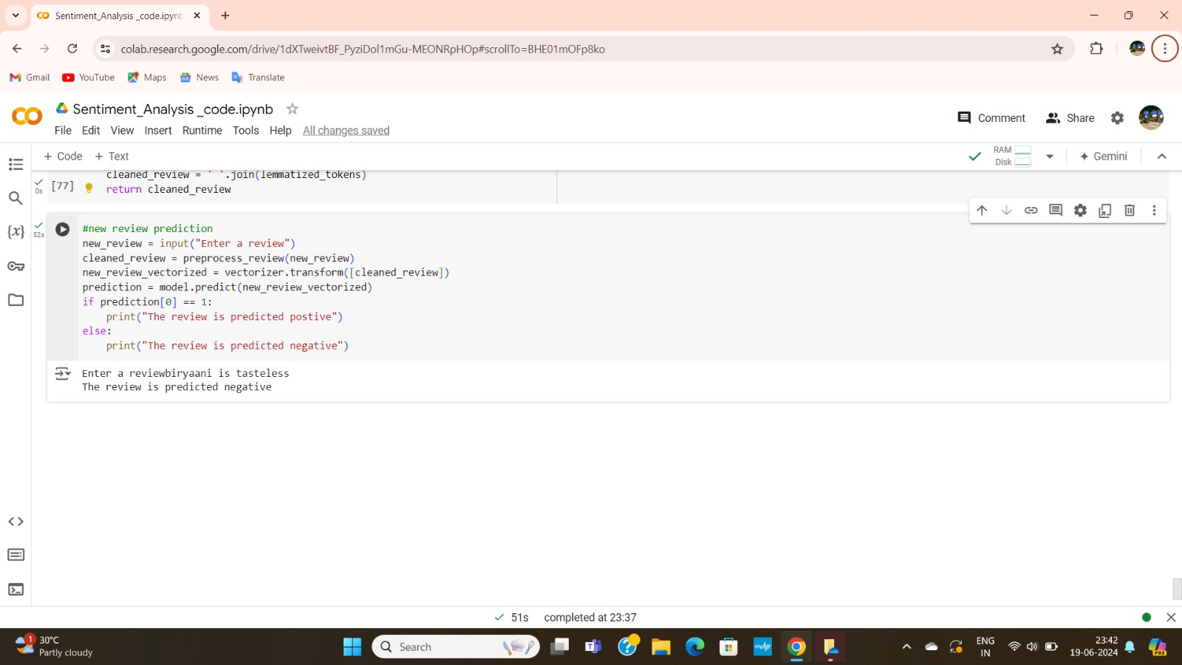
Output

Slide 9
CONCLUSION
Advanced sentiment analysis offers invaluable insights into the quality of restaurant services and customer satisfaction. Positive feedback often underscores excellence in food quality, attentive service, and a warm ambiance. Conversely, negative sentiments pinpoint critical issues such as slow service or inconsistent food standards that demand immediate attention.
Implementing sentiment analysis enables restaurants to align their strategies more effectively with customer expectations, fostering a customer-centric ethos. Addressing concerns related to service speed and food consistency not only boosts customer satisfaction but also cultivates loyalty. Continuous monitoring of sentiment trends allows for agile adjustments to meet changing customer preferences, ensuring sustained service excellence over time.
In conclusion, sentiment analysis empowers restaurants to continually enhance their operations by translating customer feedback into actionable insights. This data-driven approach optimizes efficiencies, minimizes risks, and enhances overall dining experiences. It underscores the commitment to delivering exceptional service that consistently exceeds customer expectations, thereby bolstering the restaurant's standing in the competitive hospitality industry.

Slide 10
Enhanced Customer Interactions: Utilize sentiment analysis to tailor customer interactions based on feedback, enriching dining experiences and overall satisfaction.
Real-Time Feedback Mechanisms: Implement systems for instant feedback collection and analysis, facilitating swift service enhancements and proactive engagement with customers.
Integration with AI and IoT: Integrate sentiment analysis with AI and IoT technologies to monitor customer experiences in real-time, enabling timely adjustments and personalized recommendations.
Predictive Analytics: Develop predictive models using sentiment data to foresee customer preferences, optimizing restaurant operations such as menu offerings and staffing decisions.
Benchmarking and Best Practices: Establish benchmarks for sentiment analysis in the restaurant sector to gauge performance and uncover strategies for continual enhancements in customer service and operational efficiency.
FUTURE SCOPE

Slide 11
REFERENCES
Liu, Y., & Joo, E. (2019). "Restaurant review mining and sentiment classification using machine learning techniques." Journal of Hospitality Marketing & Management, 28(6), 690-711. doi: 10.1080/19368623.2019.1566290
Hu, M., & Liu, B. (2004). "Mining and summarizing customer reviews." Proceedings of the Tenth ACM SIGKDD International Conference on Knowledge Discovery and Data Mining, 168-177. doi: 10.1145/1014052.1014073
Ghose, A., & Ipeirotis, P. G. (2007). "Designing novel review ranking systems: Predicting the usefulness and impact of reviews." Proceedings of the Ninth International Conference on Electronic Commerce, 303-310. doi: 10.1145/1282100.1282142
Zhao, Y., & Li, X. (2018). "Predicting restaurant ratings using text mining of online reviews." International Journal of Hospitality Management, 74, 147-159. doi: 10.1016/j.ijhm.2018.02.003
Zhang, X., & Varian, H. (2006). "Predicting the present with Google Trends." Economic Record, 88(S1), 2-9. doi: 10.1111/j.1475-4932.2012.00809.x

Slide 12
THANK YOU

